Slide 1
Bender v7r0 as your analysis environment
Vanya BELYAEV

Slide 2
References
Bender Pages and Bender pages by Lena Mayatskaya
Bender mailing list
Bender Savannah portal ( news, bugs, tasks, …)
Bender Tutorial: slides & instructions
Bender HyperNews, TWiki, FAQ, User Guide and Manual : ☹ not yet. still in the bottle of inc
Bender Examples
  including nice scripts from Diego for B_{s}→μμ background studies
    getpack Ex/BenderExample v7r0
“Bender-helpdesk@lhcb.cern.ch”
  1-R-010 at CERN
  +41 (0) 22 767 89 28

Slide 3
When use Bender
Python: perfect for prototyping
    e.g. develop the cuts for preselection/stripping
Interactive: perfect for “short” (“supervising”) tasks
    resolutions
    spectra
    “reflections”
Flexible & Friendly:
    good for “the final” analysis of small data sets
    combine with Root, Panoramix, RooFit,…

Slide 4
When no Bender
Stripping does not support Bender.
Reasons?
  ☹ Some CPU penalty for Bender selections vs LoKi selections is unavoidable (Python vs C++)
      could be visible/sizeable for “minimal” job
        mainly comes from the explicit loops, ntuples and explicit manipulations with dictionaries:
        sqrt(p.px()*p.px()+p.py()*p.py())
      could be very small for realistic selection
        And of course for well-coded lines
Negligible with patterns (C++) ☺

Slide 5
Bender v7r0
The most fresh version of Bender, based on DaVinci v19r1 – official DC06 stripping version
The tutorial slides are attached to the agenda
  Here only some highlights:
    It is already slide #5, and I have only 30 minutes
If somebody needs, I would be happy to organize “hands-on” Bender tutorial similar to tutorials in Beijin & Dortmund or semiprivate tutorial for HLT guys.

Slide 6
Minimal Bender script
Well, It is not Bender, it is GaudiPython
from bendermodule import *
gaudi.config( files =
[‘MyOptionsFile.opt’])
gaudi.run(10)
gaudi.exit()
Take care about input data!!
../solution/Minimalistic_0.py

Slide 7
Minimal Bender module
from bendermodule import *
def configure() :
  gaudi.config( files =
  [‘MyOptionsFile.opts’])
  return SUCCESS
if __name__ == ‘__main__’ :
  configure()
  gaudi.run(100)
Application and Components Configuration
Job steering
../solutions/Minimalistic.py

Slide 8
Scripts vs modules
Dilemma in Python: scripts vs modules
Scripts are a bit more intuitive and a bit easier to write
  Problems with reusing ☺
Modules require some discipline & conventions ☹
  full power of OO, including classes & extensions
  Easy to import and reuse ☺
  the only way to assemble “large” application from pieces
Be friendly: code modules
  loose nothing
  gain a lot

Slide 9
Scripts versus modules
Script above:
  import myscript
Will execute everything out of control
Module above:
  import mymodule
  mymodule.config()
  gaudi.run(100)

Slide 10
“Hello, World!” (I)
The simplest possible BENDER “algorithm”
Follow LoKi’s style:
  inherit the algorithm from useful base class
  (re)implement the “analyse” method
class HelloWorld(Algo) :
  def analyse( self ) :
    print ‘Hello, World!’
    return SUCCESS
../solutions/HelloWorld.py

Slide 11
“Hello, World!” (II)
One needs to instantiate the algorithm
  alg = HelloWorld( ‘Hello’ )
Add it to the list of ‘active’ algorithms
  gaudi.addAlgorithm( alg )
Execute ☺
  gaudi.run(10)
Application Configuration
Part of job steering block
../solutions/HelloWorld.py

Slide 12
Access to the data (LoKi’s style)
C++: GaudiAlgorithm/LoKi
const MCParticles* mcps = get<MCParticles>(‘MC/Particles’ )
Python: Bender
  Get as ‘native’ object:
    mcps = self.get(‘MC/Particles’)
Semantics to be improved
../solutions/DataAccess.py

Slide 13
Access to the data using service
Inside the algorithm
  dataSvc = self.evtSvc()
  hdr = dataSvc[‘Header’]
  print ‘Event #’, hdr.evtNum()
Outside the algorithms
  dataSvc = gaudi.evtSvc()
  hdr = dataSvc[’Header’]
  print ‘Run #’, hdr.runNum()
No gain
The only way!

Slide 14
Attributes and (python) loops
MCParticle
for mcp in mcps :
  print ‘ID=‘ , nameFromPID( mcp.particleID() )
  print ‘PX=‘ , mcp.momentum().px()
  print ‘PY=‘ , mcp.momentum().py()
To know the available attributes:
    help( obj )
    help( type( obj ) )
    dir(gbl)
ON-LINE help for ALL Python/Bender functions/classes, sometimes it is VERY useful
From Dictionaries
../solutions/DataAccess.py

Slide 15
Lets start with physics analysis
>95% of LoKi’s idioms are in Bender
The semantic is VERY similar
  In spite of different languages
  few ‘obvious’ exceptions
In the game:
  All Functions/Cuts
    a bit more round braces are required
  All (v,mc,mcv)select methods
  loops , plots
  for N-Tuples the functionality is a bit limited
    A lack of template methods,
    ‘farray’ need to be validated
  Start from MC-truth (requires no special configurations)
Pere knows solution!

Slide 16
MCselect statement
Selection of MCParticles which satisfy the certain criteria:
  mcmu = self.mcselect( ‘mcmu’ ,
  ‘mu+’ == MCABSID )
  beauty = self.mcselect(‘beauty’ , BEAUTY )
Refine criteria:
  muFromB = self.mcselect ( ‘muFromC’,
  mcmu ,
  FROMMCTREE( beauty ) )
  muPT = self.mcselect( ‘withPT’ ,
  muFromB ,
  ( MCPT > 1000 ) )
LUG, Tab. 13.4, p.84
Select μ⁺ & μ⁻
Everything which has b or b̄
Everything from “decay” trees (incl. decay-on-flight)
../solutions/MCmuons.py

Slide 17
Change input data
Get and configure EventSelector
  evtSel = gaudi.evtSel()
  evtSel.open( “file”)
OR
  evtSel.open( [ “file1”, “file2”] )
e.g.
evtSel.open ( ‘LFN:/lhcb/production/DC04/v1/DST/00000543_00000017_5.dst’)
List of input files

Slide 18
Find MC–tree ( IMCDecayFinder )
Brilliant tool from O.Dormond
find the MC-decay trees:
mc = self.mcFinder()
trees = mc.find(
‘[B_s0 -> (J/psi(1S) -> mu+ mu-) phi(1020)]cc’ )
find MC-decay tree components:
phis = mc.find(
‘ phi(1020) : [B_s0 -> (J/psi(1S) -> mu+ mu-) phi(1020)]cc’ )
extract ‘marked’ MC-decay tree components:
mus = mc.find(
‘ [B_s0 -> (J/psi(1S) -> mu+ ^mu-) phi(1020)]cc’ )
Container(“Range”) of MCParticles
Container(“Range”) of MCParticles
../solutions/MCTrees.py

Slide 19
Add simple histos!
for mu in mus :
  self.plot ( MCPT( mu ) / 1000 ,
  ‘PT of muon from J/psi’ ,
  0 , 10 )
  The default values : #bins = 100, weight = 1
Configuration for HBOOK histograms:
  gaudi.HistogramPersistency = ‘HBOOK’
  hsvc = gaudi.service(‘HistogramPersistencySvc’)
  hsvc.OutputFile = ‘myhistos.hbook’
MCParticle
To be improved!
../solutions/MCTrees.py

Slide 20
Add the simple N-Tuple
tup = self.nTuple( ‘My N-Tuple’ )
zOrig = MCVXFUN( MCVZ )
for mu in mus :
  tup.column( ‘PT’, MCPT ( mu ) )
  tup.column( ‘P’ , MCP ( mu ) )
  tup.column( ‘Z’ , zOrig ( mu ) )
  tup.write()
Configuration:
  myAlg = g.algorithm( ‘McTree’ )
  myAlg.NTupleLUN = ‘MC’
  ntsvc = g.service(‘NTupleSvc’)
  ntsvc.Output =
  [“MC DATAFILE=‘tuples.hbook’ TYP=‘HBOOK’ OPT=‘NEW’ ”]
To be improved
../solutions/MCTrees.py

Slide 21
Component Properties
Algorithms
  alg = gaudi.algorithm(‘MyAlg’)
  alg.NTupleLUN = ‘LUNIT’
Services
  hsvc = gaudi.service(‘HistogramPersistencySvc’)
  hsvc.OutputFile = ‘histo.file’
Tools
  tool = gaudi.property(‘MyAlg.PhysDesktop’)
  tool.InputLocations = [‘Phys/StdLooseKaons’]
MyAlg.NTupleLUN = “LUNIT” ;
HistogramPersistencySvc.OutputFile = “histo.file”;
MyAlg.PhysDesktop.InputLocations = {“Phys/stdLooseKaons”};

Slide 22
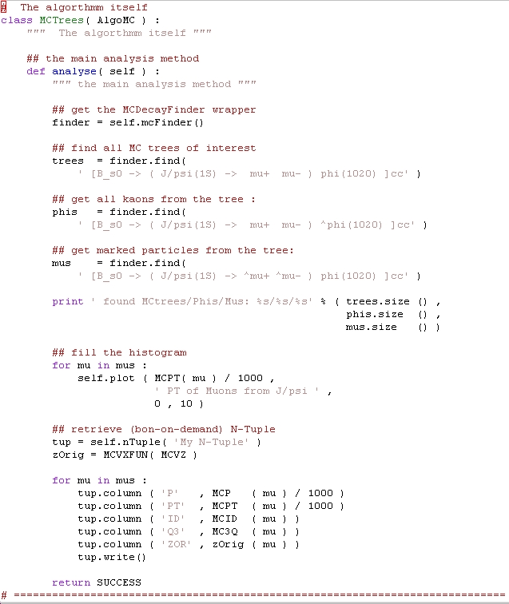
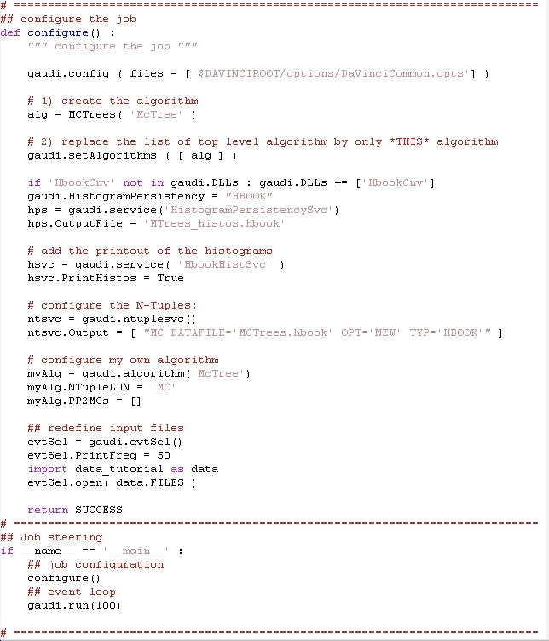
../solutions/MCTrees.py

Slide 23
Go from MC to RC data
At this moment one knows how to:
  Deal with MC trees, decays, particles
  Perform simple (python) loops
  Deal with the histograms & N-Tuples
    Some knowledge of ‘configuration’
For RC data one must perform non-trivial algorithm configuration to be able to run
  Input for RC particles (or ParticleMaker)
  Dependency on ‘other’ algorithms ( ‘PreLoad’ )

Slide 24
Algorithm configuration
desktop = gaudi.property(‘MyAlg.PhysDesktop’)
desktop.InputLocations = [ “Phys/StdLooseKaons” ]
Similar semantic in configuration ( ‘*’.opts ) files:
  MyAlg.PhysDesktop.InputLocations={“Phys/StdLooseKaons”} ;
../solutions/RCSelect.py

Slide 25
select/loop statements
muons = self.select ( ‘mu’ ,
( ‘mu+’== ABSID ) & ( PT > (1*GeV) ) )
kaons = self.select ( ‘K’ ,
( ‘K+’== ABSID ) & ( PIDK > 0 ) )
Loops:
  psis=self.loop( ‘mu mu’, ‘J/psi(1S)’)
  phis=self.loop( ‘K K’ , ‘phi(1020’)
LUG, Tab. 13.2, p.62-77
../solutions/RCSelect.py

Slide 26
Inside the loops (I)
dmcut = ADMASS(‘J/psi(1S)’) < 50
for psi in psis :
  if not 2500 < psi.mass(1,2) <3500 : continue
  if not 0 == SUMQ( psi ) : continue
  if not 0 <= VCHI2( psi ) < 49 : continue
  self.plot ( M(psi)/1000 ,
  “ di-muon invariant mass” ,
  2.5 , 3.5 )
  if not dmcut( psi ) : continue
  psi.save(‘psi’)
psis = self.selected(‘psi’)
print ‘# of selected J/psi candidates:‘, psis.size()
Σq = 0
χ²VX < 49
|ΔM|<50 MeV/c²
../solutions/RCSelect.py

Slide 27
Inside the loops (II)
dmcut = ADMASS(‘phi(1020’) < 12
for phi in phis :
  if not phi.mass(1,2) < 1050 : continue
  if not 0 == SUMQ( phi ) : continue
  if not 0 <= VCHI2( phi ) < 49 : continue
  self.plot ( M( phi ) / 1000 ,
  “ di-kaon invariant mass” ,
  1.0 , 1.050 )
  if not dmcut( phi ) : continue
  phi.save(‘phi’)
phis = self.selected(‘phi’)
print ‘# of selected phi candidates:‘, phis.size()
Σq = 0
χ²VX < 49
|ΔM|<12 MeV/c²
../solutions/RCSelect.py

Slide 28
Inside the loops (III)
dmcut = ADMASS(‘B_s0’ ) < 100
bs = self.loop ( ‘psi phi’ , ‘B_s0’ )
for B in bs :
  if not 4500 < B.mass(1,2) < 6500 : continue
  if not 0 <= VCHI2( B ) < 49 : continue
  self.plot ( M( B ) / GeV ,
  “ J/psi phi invariant mass” ,
  5.0 , 6.0 )
  if not dmcut( B ) : continue
  B.save(‘Bs’)
Bs = self.selected(‘Bs’)
print ‘# of selected Bs candidates:‘, Bs.size()
if not Bs.empty() : self.setFilterPassed ( TRUE )
../solutions/RCSelect.py

Slide 29
The last step: MC-truth match
The simplest case: check if RC particle originates from the certain MC-(sub)tree
  The most frequent case
    Check for efficiencies
    Resolution
The opposite task: what MC particle “corresponds” to RC particle
  similar ( MCTRUTH → RCTRUTH )
NB: LoKi (and Bender) uses own concept of MC “loose” matching
  LUG, chapter 15

Slide 30
MC-truth match
finder = self.mctruth(‘some name’)
Select MC-particles
mcBs = finder.find(
‘ [B_s0 -> (J/psi(1S) -> mu+ mu-) phi(1020)]cc ’ )
mcPhi = finder.find(
‘ phi(1020) : [B_s0 -> (J/psi(1S) -> mu+ mu-) phi(1020)]cc ’ )
mcPsi = finder.find(
‘ J/psi(1S) : [B_s0 -> (J/psi(1S) -> mu+ mu-) phi(1020)]cc ’ )
Prepare ‘MC-Truth cuts’
match = self.mcTruth(‘some name’)
mcCutBs = MCTRUTH ( match , mcBs )
mcCutPhi = MCTRUTH ( match , mcPhi )
mcCutPsi = MCTRUTH ( match , mcPsi )
../solutions/RCMCSelect.py

Slide 31
The last step: MC-truth match
for psi in psis :
if not mcCutPsi ( psi ) : continue
…
for phi in phis :
if not mcCutPhi ( phi ) : continue
…
for B in bs :
if not mcCutBs ( B ) :continue
…
Alternatively :
for B in bs :
psi = B(1)
phi = B(2)
…
tup.column ( ‘mcpsi’ , mcCutPsi( psi ) )
tup.column ( ‘mcphi’ , mcCutPhi( phi ) )
tup.column ( ‘mc’ , mcCutBs ( B ) )
tup.write()
../solutions/RCMCSelect.py

Slide 32
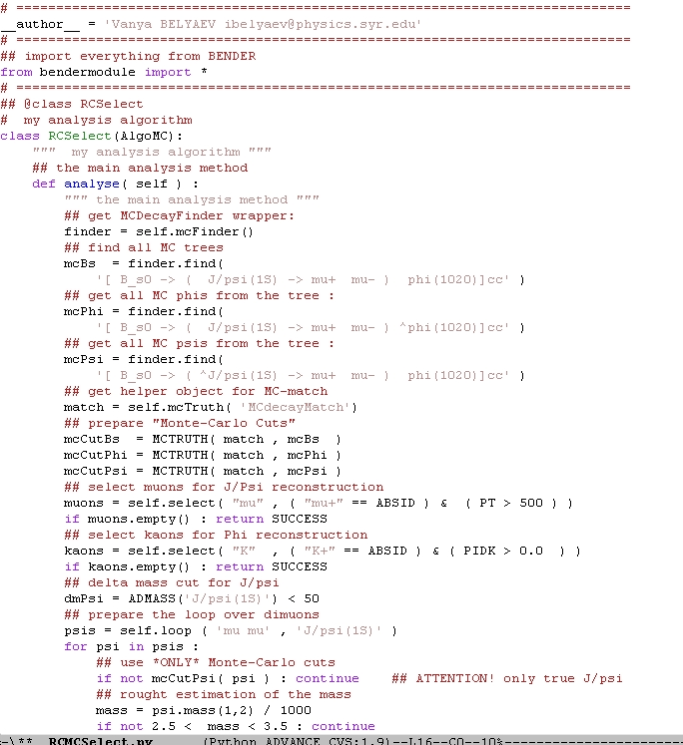
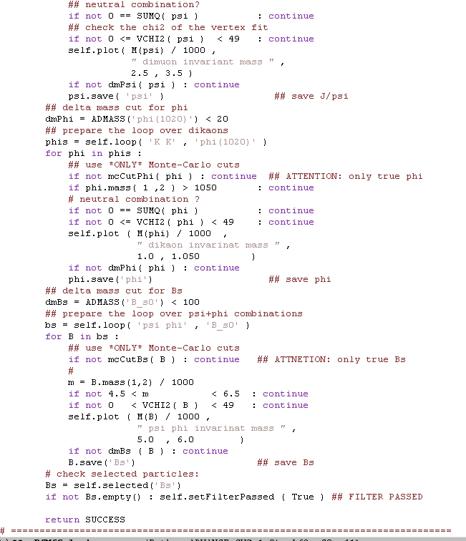
../solutions/RCMCSelect.py

Slide 33
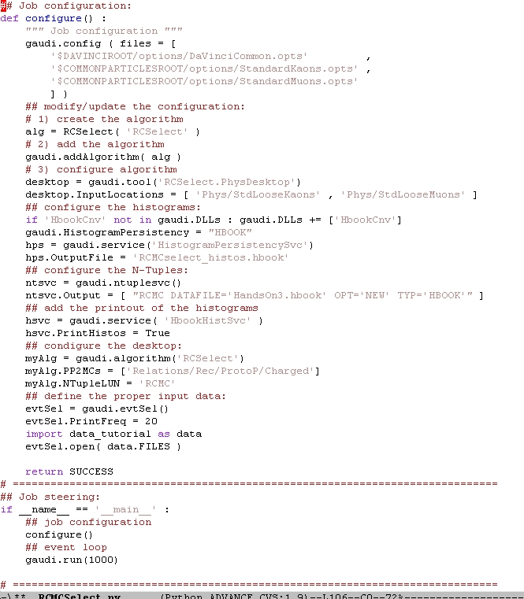
../solutions/RCMCSelect.py
Algorithm: 81 lines
  55% - comments
Configuration& steering: 44 lines
  40% comments
Select true “reconstructed” Bs with loose cuts: fine for cuts envestigation

Slide 34
Other features, out of scope
Nice printout of trees, particles, events
Various “extractors” and metafunctions
HepMC + HepMCParticleMaker
Jets
Tools for background origin studies
Patterns
and much much more…
As concerns the functionality needed for analysis, Bender is full scale application, widely used for many physics studies.

Slide 35
References again…
Bender Pages and Bender pages by Lena Mayatskaya
Bender mailing list
Bender Savannah portal ( news, bugs, tasks, …)
Bender Tutorial: slides & instructions
Bender HyperNews, TWiki, FAQ, User Guide and Manual : ☹ not yet. still in the bottle of inc
Bender Examples
  including nice scripts from Diego for B_{s}→μμ background studies
    getpack Ex/BenderExample v7r0
“Bender-helpdesk@lhcb.cern.ch”
  1-R-010 at CERN
  +41 (0) 22 767 89 28

